Slide 1

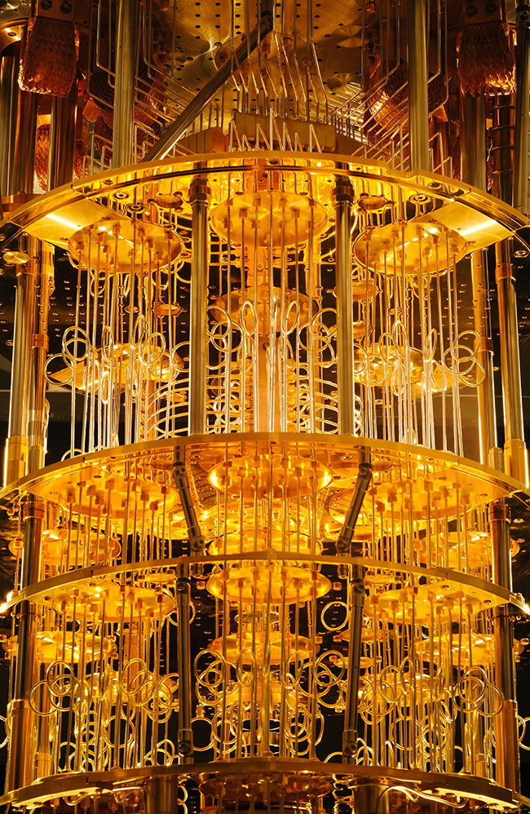
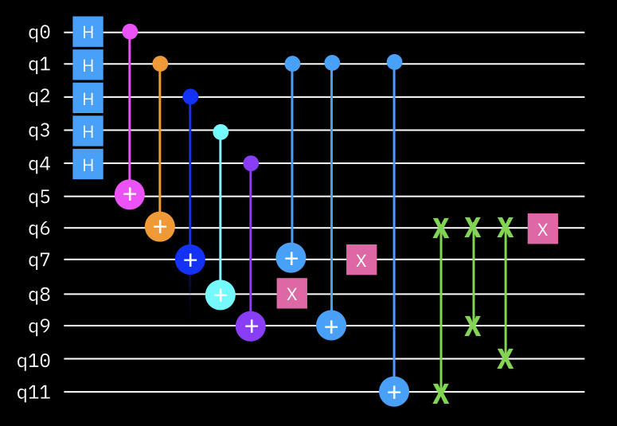
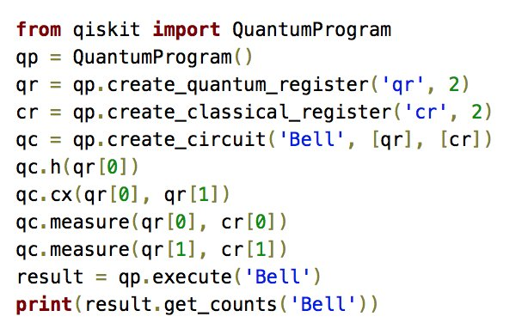
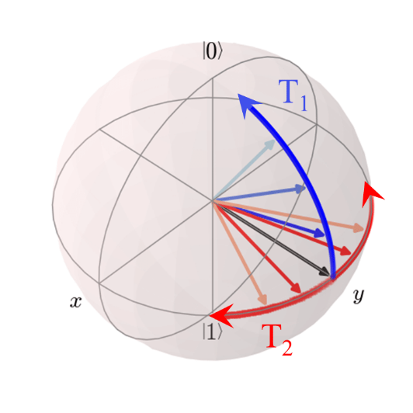

Foundations of
Quantum Computing
(QIS 301)
Dave Biersach
Brookhaven National Laboratory
dbiersach@bnl.gov
Session 08
Sinusoidal Waves

Slide 2
Session Goals
Review the key parts of a sinusoidal transverse wave
Appreciate the affect of sampling rate on aliasing
Understand the Nyquist Sampling Theorem
Consider the kinematics of a travelling wave, as it relates to amplitude, wavelength, and frequency
Create a standing wave via superposition

Slide 3
All of Physics is Waves
Electrical
Magnetic
Acoustic
Heat Flow
Vibrational
Torsional
Nuclear / Quantum
Gravitational
Oceanic / Tidal
Orbital Precession
Springs
Pendulums
Tomography
Stock Market
Economics
Astronomical
Fluid Dynamics
Earthquakes
AC / DC
AM / FM
Speech
Heartbeats
It is really important that you develop a keen
understanding of the mathematics of waves!

Slide 4
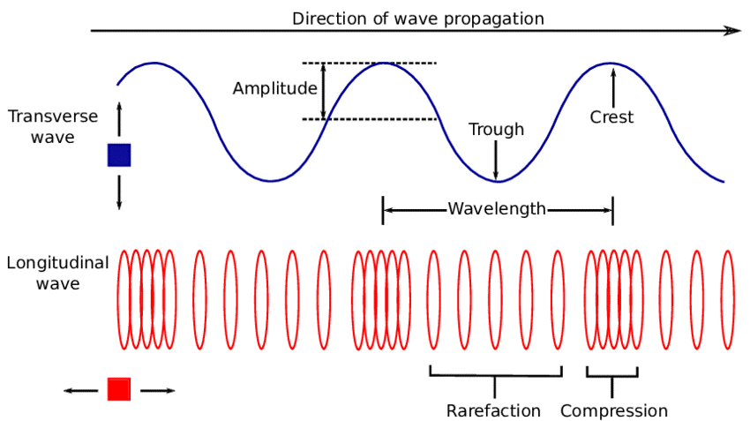
Wave Types

Slide 5
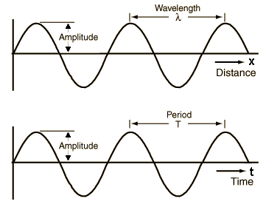
Transverse Wave Components

Slide 6
Transverse Wave Components

Slide 7
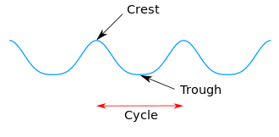


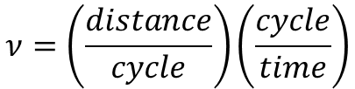



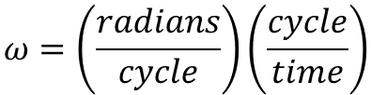




Transverse Wave Components
$$2π=\frac{radians}{cycle}$$
$$Angular velocity=ω=\frac{radians}{time}$$
$$ω=\left(\frac{radians}{cycle}\right)\left(\frac{cycle}{time}\right)$$
$$Period=T=\frac{time}{cycle}$$
$$ω=2πf$$
$$Frequency=f=\frac{cycle}{time}=\frac{1}{T}$$
$$Wave velocity=ν=\frac{distance}{time}$$
$$Wavelength=λ=\frac{distance}{cycle}$$
$$ν=\left(\frac{distance}{cycle}\right)\left(\frac{cycle}{time}\right)$$
$$Wavenumber=k=\frac{2π}{λ}$$
$$ν=λf$$

Slide 8
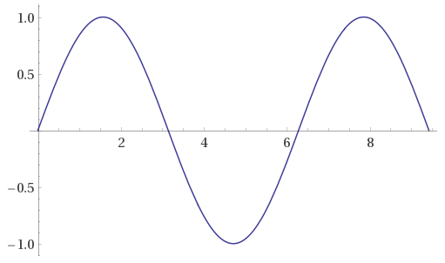

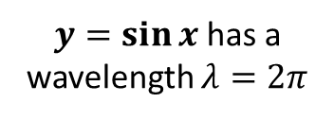





Transverse Wave Components
$$y=\sin{x}$$
$$2π$$
$y=\sin{x}$ has a wavelength $λ=2π$
$$\frac{π}{2}$$
$$\frac{π}{2}+2π$$
$$sin\left(\frac{π}{2}\right){=1}$$
1
0
Crest to Crest
$$\sin\left(\frac{π}{2}+2π\right)=\sin{\frac{π}{2}\cos{2π+\cos{\frac{π}{2}\sin{2π}}}=1}$$

Slide 9
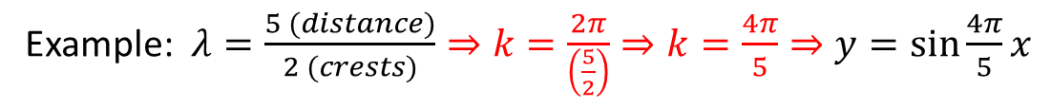
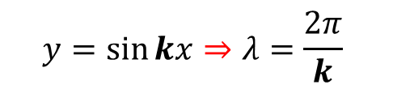

Transverse Wave Components
$y=\sin{x}$ has a wavelength $λ=2π$
if k = 1
$$Wavenumber=k=\frac{2π}{λ}$$
$$y=\sin{kx}⇒λ=\frac{2π}{k}$$
Example: $λ=\frac{5 (distance)}{2 (crests)}⇒k=\frac{2π}{\left(\frac{5}{2}\right)}⇒k=\frac{4π}{5}⇒y=\sin{\frac{4π}{5}x}$

Slide 10
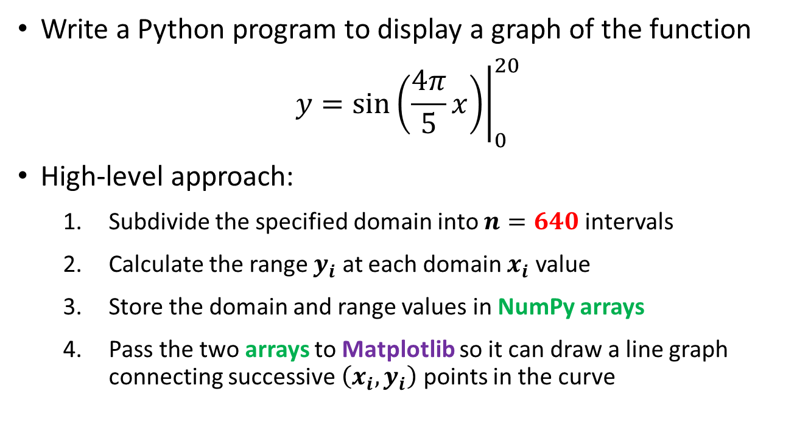
Known Wave Aliasing
Write a Python program to display a graph of the function
$$y={\left.\sin\left(\frac{4π}{5}x\right)\right|}_{0}^{20}$$
High-level approach:
Subdivide the specified domain into $n=640$ intervals
Calculate the range $y_{i}$ at each domain $x_{i}$ value
Store the domain and range values in NumPy arrays
Pass the two arrays to Matplotlib so it can draw a line graph connecting successive $\left(x_{i},y_{i}\right)$ points in the curve
2 crests per every 5 lengths

Slide 11
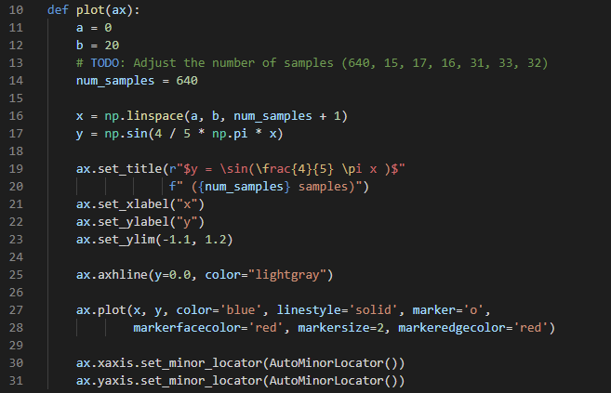


Open nyquist_known.py
①
②
③
The last sample needs an endpoint
④
⑤
⑥
$$y=\sin{θ=[−1,1]}$$
⑦
⑧

Slide 12
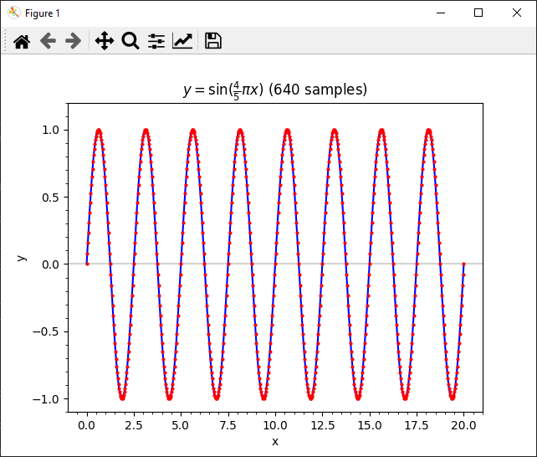
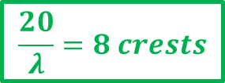

Run nyquist_known.py
$$\frac{20}{λ}=8 crests$$
$$λ=\frac{5}{2}=2.5$$

Slide 13
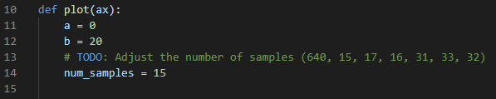
Edit nyquist_known.py
Edit the code so that n = 15 and then run it again
Edit the code so that n = 17 and then run it again
Then set n = 16 and run it again – now what happens?

Slide 14
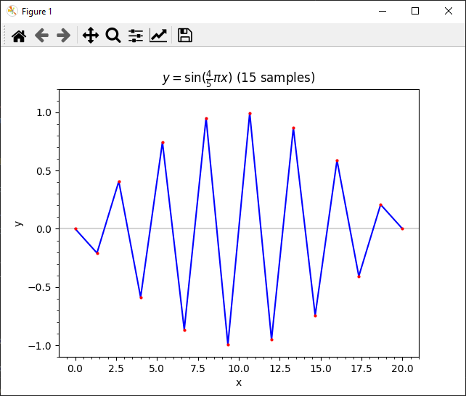
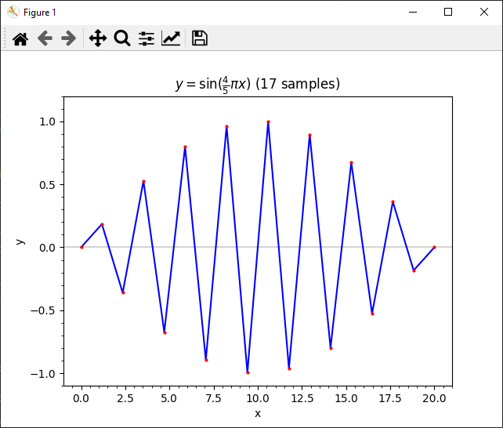
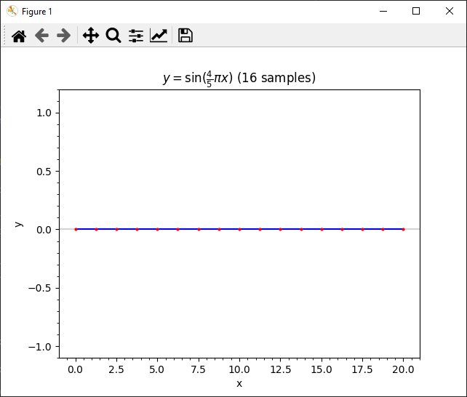
Run nyquist_known.py
What happens with n = 16 ?

Slide 15
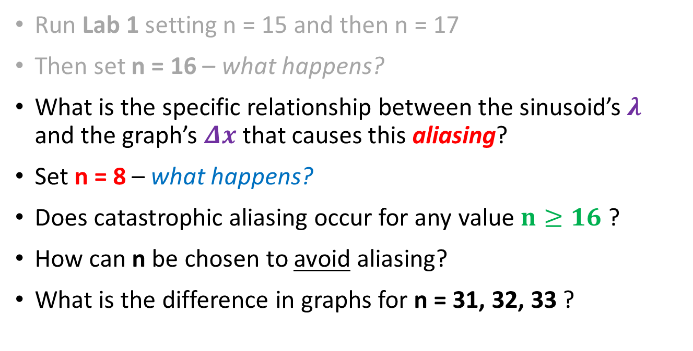
Edit nyquist_known.py
Run Lab 1 setting n = 15 and then n = 17
Then set n = 16 – what happens?
What is the specific relationship between the sinusoid’s$λ$ and the graph’s $Δx$ that causes this aliasing?
Set n = 8 – what happens?
Does catastrophic aliasing occur for any value $n≥16$ ?
How can n be chosen to avoid aliasing?
What is the difference in graphs for n = 31, 32, 33 ?

Slide 16
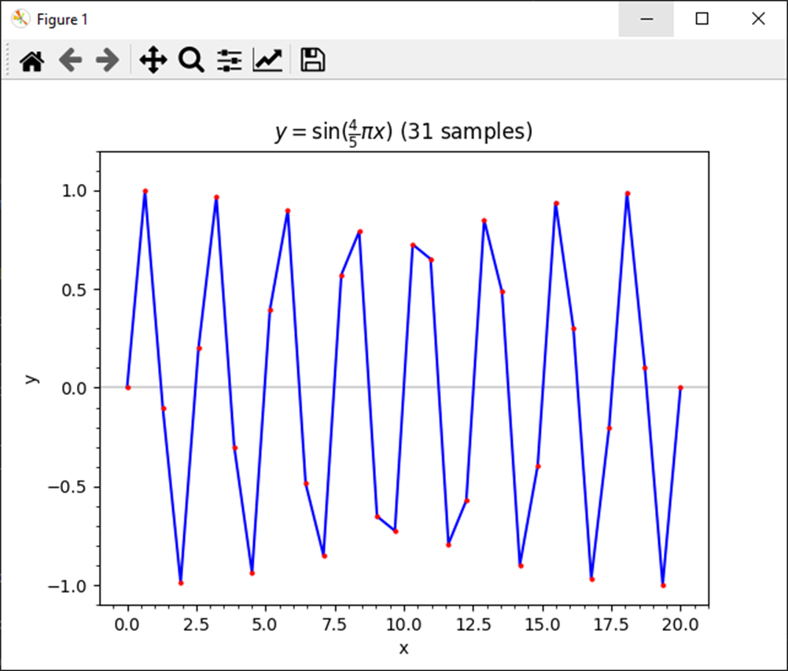
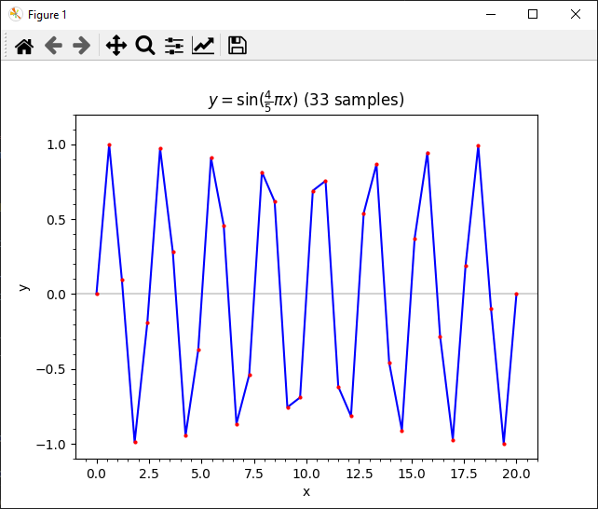
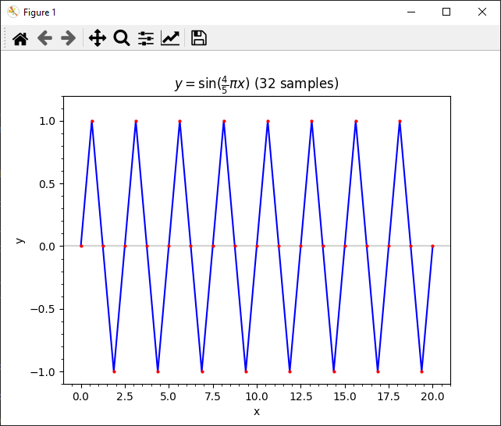
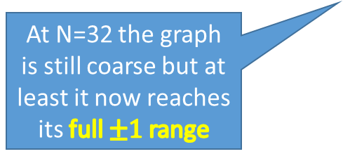
Run nyquist_known.py
At N=32 the graph is still coarse but at least it now reaches its full $±1$range

Slide 17
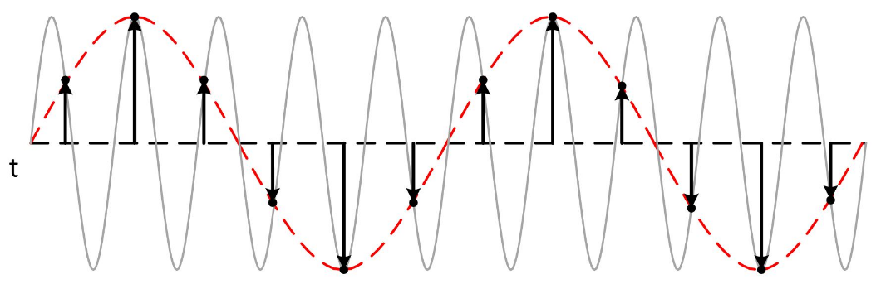

Nyquist Sampling Theorem
To minimize aliasing (data loss), if you know $λ$ ahead of time, set $n=\left(\frac{2}{λ}\right)\left(b−a\right)\left(2r\right), where r∈ℤ^{+}$
This rule is the Nyquist Sampling Theorem
You need at least 2x as many samples as the highest frequency you intend to capture
This wave is under sampled (n is too low!)

Slide 18
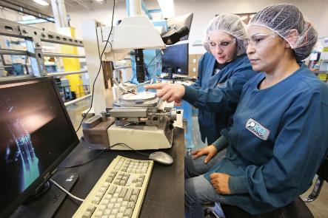
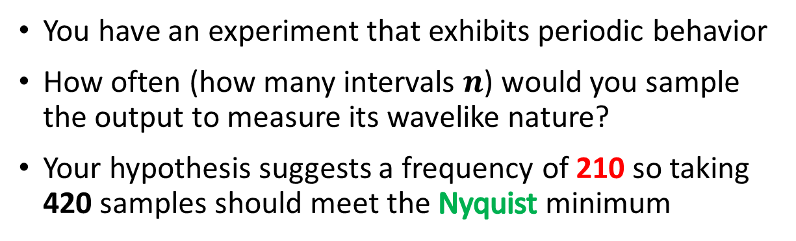
Unknown Wave Aliasing
You have an experiment that exhibits periodic behavior
How often (how many intervals $n$) would you sample the output to measure its wavelike nature?
Your hypothesis suggests a frequency of 210 so taking 420 samples should meet the Nyquist minimum

Slide 19
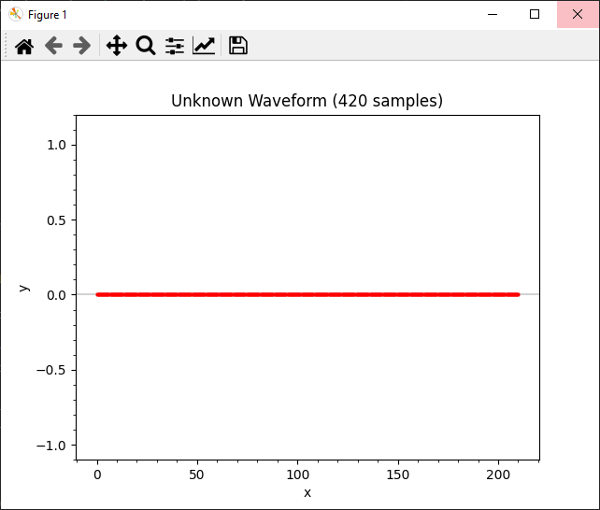
Run nyquist_unknown.py

Slide 20
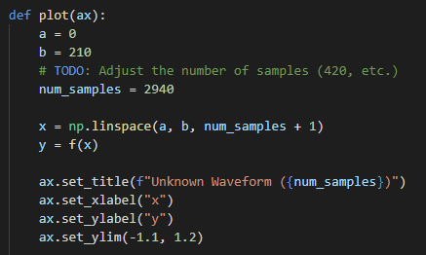


Edit nyquist_unknown.py
Okay, we going to take 14x more samples!

Slide 21
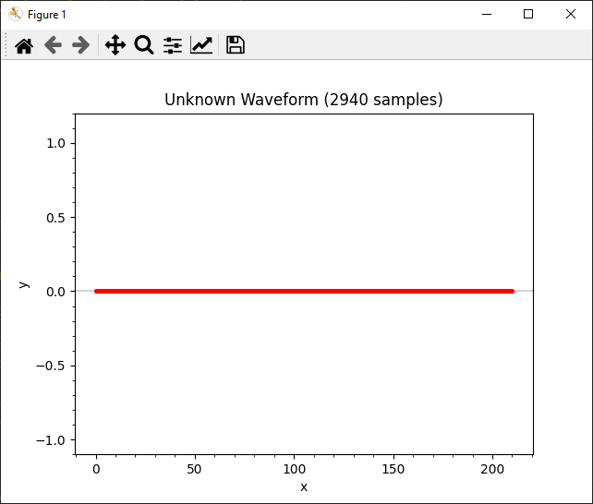
Run nyquist_unknown.py
Even after taking so many samples (2940) we still have catastrophic aliasing!

Slide 22
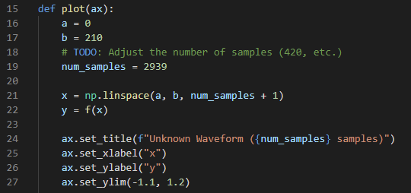

Edit nyquist_unknown.py
What if we take just one less sample (2939) during the experiment?

Slide 23
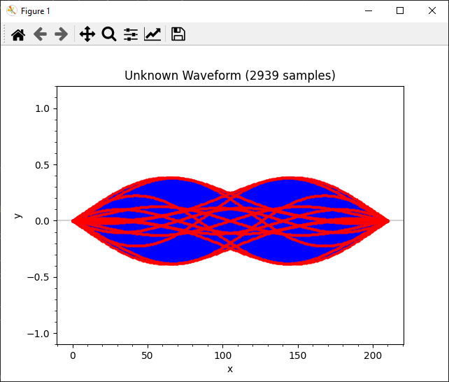
Run nyquist_unknown.py
Taking one less sample made all the difference – why?
Now we can finally see the wave in its true form

Slide 24
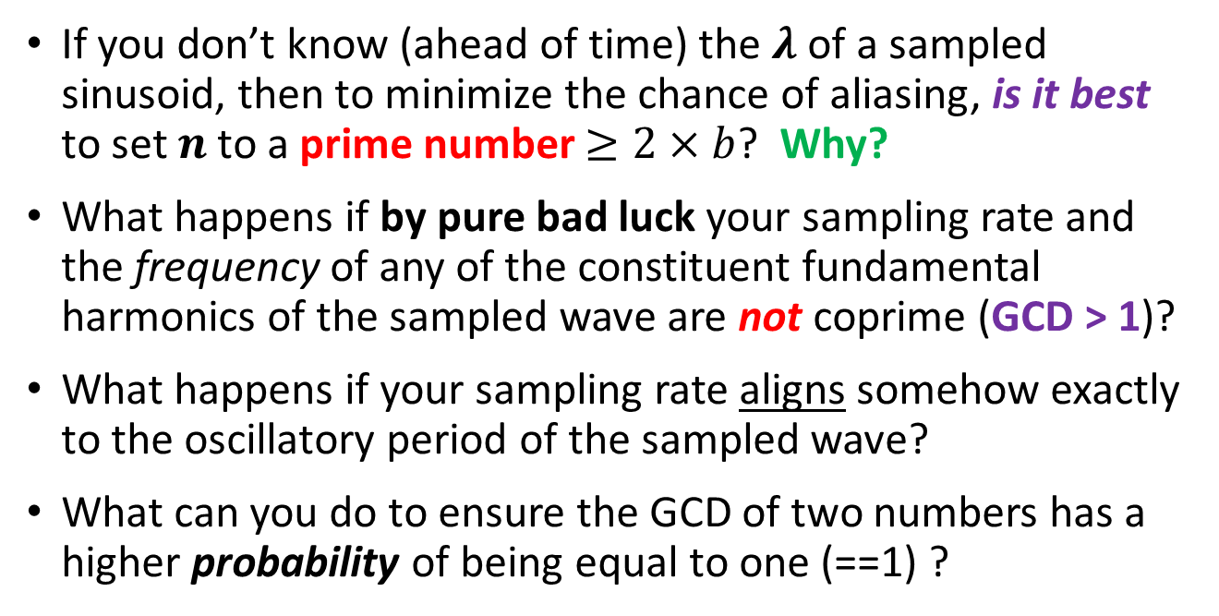
Research Questions
If you don’t know (ahead of time) the $λ$ of a sampled sinusoid, then to minimize the chance of aliasing, is it best to set $n$ to a prime number $≥2×b$? Why?
What happens if by pure bad luck your sampling rate and the frequency of any of the constituent fundamental harmonics of the sampled wave are not coprime (GCD > 1)?
What happens if your sampling rate aligns somehow exactly to the oscillatory period of the sampled wave?
What can you do to ensure the GCD of two numbers has a higher probability of being equal to one (==1) ?

Slide 25

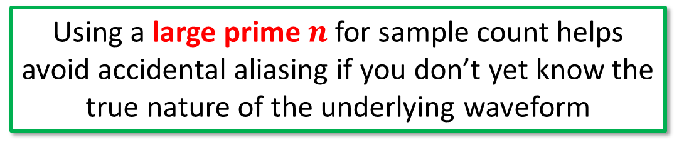
Avoiding Sample Aliasing
$$y=\sin\left(4πx\right)\sin\left(6πx\right)\sin\left(10πx\right)sin⁡(14πx)$$
Using a large prime $n$ for sample count helps avoid accidental aliasing if you don’t yet know the true nature of the underlying waveform

Slide 26






Travelling Waves & Superposition
$$λ=\frac{2π}{k}→k=\frac{2π}{λ}$$
$$y_{1}=A_{1}\sin\left(k_{1}x+ω_{1}t\right)$$
These waves have both spatial and temporal components
$$y_{2}=A_{2}\sin\left(k_{2}x+ω_{2}t\right)$$
$$f=\frac{ω}{2π}→ω=2πf$$
$$y_{1}+y_{2}= ?$$
$$y_{1}=A_{1}\sin\left(k_{1}x+ω_{1}t\right)=A_{1}\sin{k_{1}x}\cos{ω_{1}t}+A_{1}\cos{k_{1}x}\sin{ω_{1}t}$$
$$y_{2}=A_{2}\sin\left(k_{2}x+ω_{2}t\right)=A_{2}\sin{k_{2}x}\cos{ω_{2}t}+A_{2}\cos{k_{2}x}\sin{ω_{2}t}$$
Simple Case: $A_{1}=A_{2}=1,ω_{1}=ω_{2}=0$
$$y_{1}=\sin{k_{1}x}\cos{0t}+\cos{k_{1}x}\sin{0t}$$
$$y_{2}=\sin{k_{2}x}\cos{0t}+\cos{k_{2}x}\sin{0t}$$
$$y_{1}+y_{2}=\sin{k_{1}x}+\sin{k_{2}x}=2\sin\left(\frac{\left(k_{1}+k_{2}\right)x}{2}\right)\cos\left(\frac{\left(k_{1}−k_{2}\right)x}{2}\right)$$

Slide 27
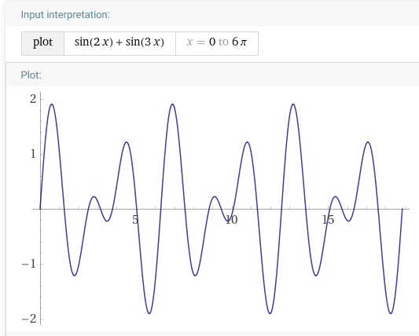
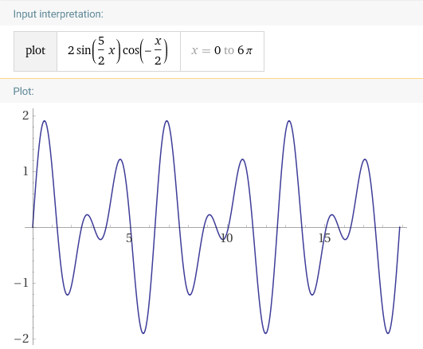
Travelling Waves & Superposition
But what if the two waves are travelling at different speeds, or have different amplitudes, or different wave numbers?

Slide 28
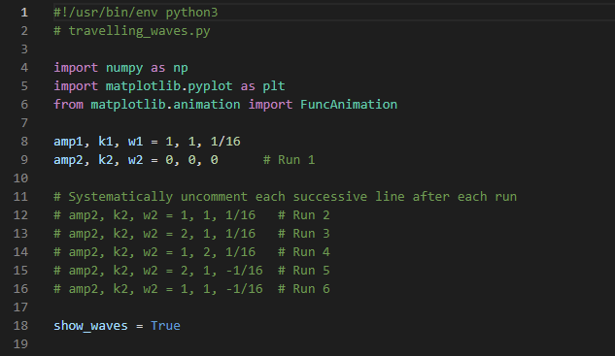




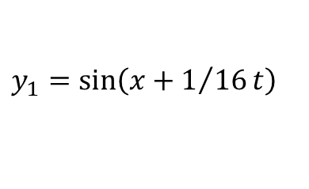
Open travelling_waves.py
①
②
$$y_{1}=\sin\left(x+1/{16}t\right)$$
$$y_{2}=0$$
$$y_{3}=\frac{y_{1}+y_{2}}{2}$$
$$y_{1}=A_{1}\sin\left(k_{1}x+ω_{1}t\right)$$
$$y_{2}=A_{2}\sin\left(k_{2}x+ω_{2}t\right)$$

Slide 29
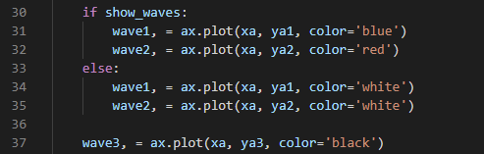
Open travelling_waves.py
①
②
③
④
$$y_{3}=\frac{y_{1}+y_{2}}{2}$$
$$y_{1}=A_{1}\sin\left(k_{1}x+ω_{1}t\right)$$
$$y_{2}=A_{2}\sin\left(k_{2}x+ω_{2}t\right)$$

Slide 30
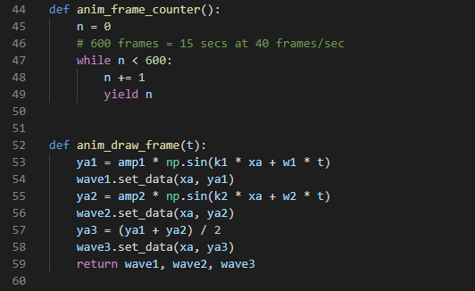
Open travelling_waves.py
①
②
$$y_{3}=\frac{y_{1}+y_{2}}{2}$$
$$y_{1}=A_{1}\sin\left(k_{1}x+ω_{1}t\right)$$
$$y_{2}=A_{2}\sin\left(k_{2}x+ω_{2}t\right)$$

Slide 31
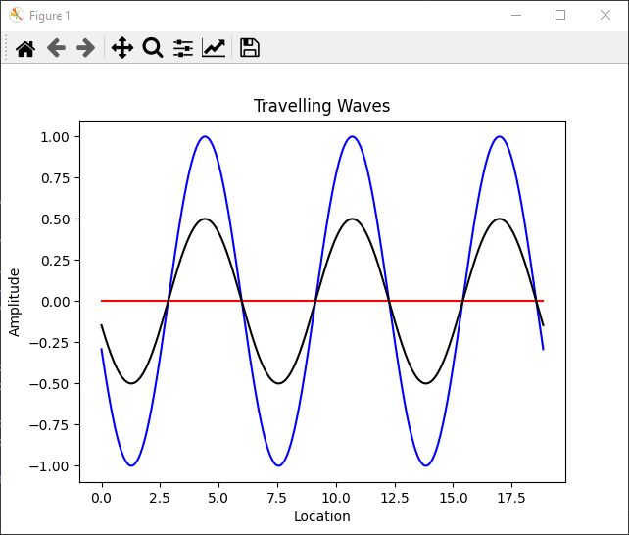



Run travelling_waves.py (Run #1)
$$y_{1}$$
$$y_{3}$$
$$y_{2}$$

Slide 32
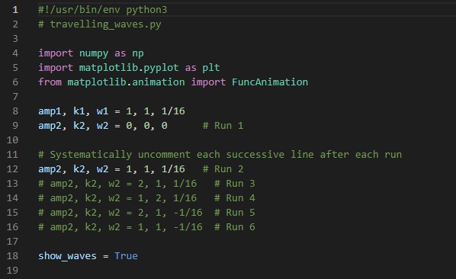

Edit travelling_waves.py (Run #2)
$$y_{1}=\sin\left(x+1/{16}t\right)$$
$$y_{2}=\sin\left(x+1/{16}t\right)$$
$$y_{3}=\frac{y_{1}+y_{2}}{2}$$
$$y_{1}=A_{1}\sin\left(k_{1}x+ω_{1}t\right)$$
$$y_{2}=A_{2}\sin\left(k_{2}x+ω_{2}t\right)$$

Slide 33
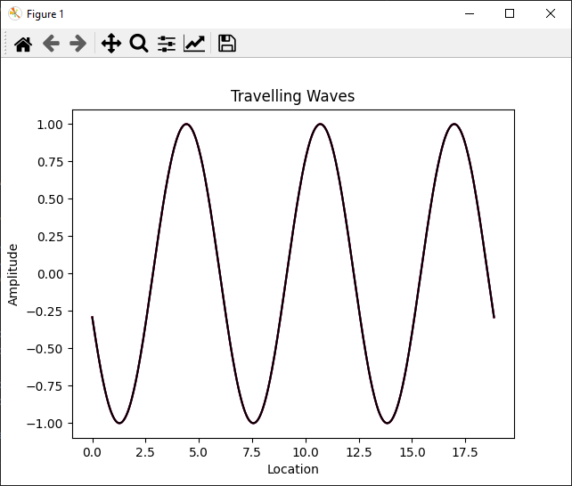
Run travelling_waves.py (Run #2)
Where did the red and blue waves go?

Slide 34
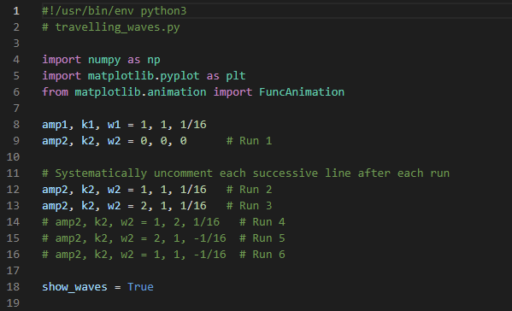

Edit travelling_waves.py (Run #3)
$$y_{1}=\sin\left(x+1/{16}t\right)$$
$$y_{2}=2 sin\left(x+1/{16}t\right)$$
$$y_{3}=\frac{y_{1}+y_{2}}{2}$$
$$y_{1}=A_{1}\sin\left(k_{1}x+ω_{1}t\right)$$
$$y_{2}=A_{2}\sin\left(k_{2}x+ω_{2}t\right)$$

Slide 35
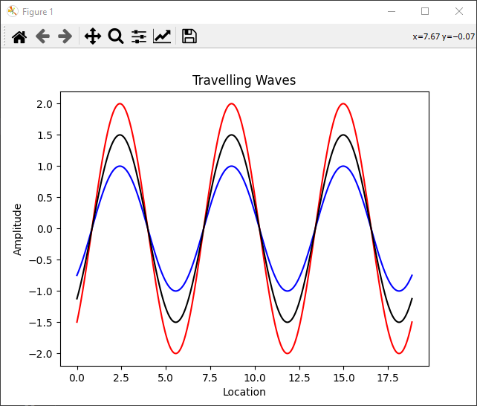
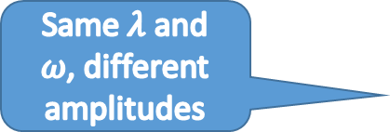
Run travelling_waves.py (Run #3)
Same $λ$ and $ω$, different amplitudes

Slide 36


Run travelling_waves.py (Run #4)
Different $λ$ but same $ω$and amplitudes

Slide 37




Run travelling_waves.py (Run #5)
$$y_{2}$$
$$y_{1}$$
Different $λ$ and amplitudes, and opposite $ω$

Slide 38






Run travelling_waves.py (Run #6)
$$y_{1}=\sin\left(x+1/{16}t\right)$$
$$y_{2}=\sin\left(x−1/{16}t\right)$$
Same $λ$ and amplitudes, and opposite $ω$
$$y_{1}$$
$$y_{2}$$

Slide 39


Edit travelling_waves.py (Run #6)
$$y_{1}=\sin\left(x+1/{16}t\right)$$
$$y_{2}=\sin\left(x−1/{16}t\right)$$
$$y_{3}=\frac{y_{1}+y_{2}}{2}$$
$$y_{1}=A_{1}\sin\left(k_{1}x+ω_{1}t\right)$$
$$y_{2}=A_{2}\sin\left(k_{2}x+ω_{2}t\right)$$

Slide 40


Run travelling_waves.py (Run #6)
The superposition of two waves having the same $λ$ but opposite $ω$ produces a standing wave
$$y_{1}=\sin\left(x+1/{16}t\right)$$
$$y_{2}=\sin\left(x−1/{16}t\right)$$
What do these circles represent?

Slide 41

Now you know…
Nyquist Sampling Theorem – to minimize aliasing (data loss):
Known wave (you know $λ$) set $n=\frac{b}{λ}r, where r∈ℤ^{+}and r≥2$
That you need at least 2x as many samples as the highest frequency you want to capture is the essence of the Nyquist Theorem
With an unknown wave (you don’t know $λ$) take a prime number of samples $\left(≥2×b\right)$ to minimize the chance of aliasing
The superposition of two travelling waves, having the same wavelength but opposite angular frequency, produces a standing wave
A standing wave still oscillates but does not travel (the location of the nodes remains constant)
Superposition is a crucial concept in quantum mechanics!

